Slide 1
A Modified Version of L-PICOLA to Output the Gravitational Potential
Notes:
Wellcome greetings.
What is the presentation about?

Slide 2
Content
Introduction – What is this modification good for?
Model equations
Modifications to L-PICOLA – What is new?
Test simulation and results
Analysis and verification
Conclusion
What comes next?
Notes:
What am I going to talk about?

Slide 3
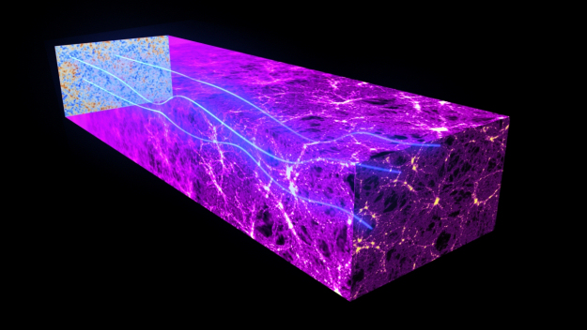
Introduction – What is this modification good for?
Output the gravitational potential at the particle positions and on the mesh.
Construct lensing-potential and deflection-angle maps of the CMB.
Much faster than GADGET-2 – 3 orders of magnitude.
Accuracy comparable to GADGET-2.
Notes:
What is our modified version doing?
What is it good for?
Are there other simulations doing the same, similar?
What are the differences between them?
What is on the image?

Slide 4
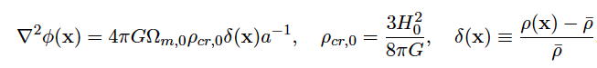
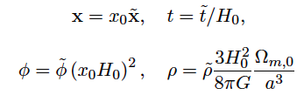
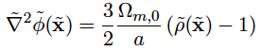
Model equations
Notes:
What is important to know before we continue?
What is written in the 1st line?
What are the new variables in the 2nd line?
What is in the 3rd line?
What is the last line describing?

Slide 5
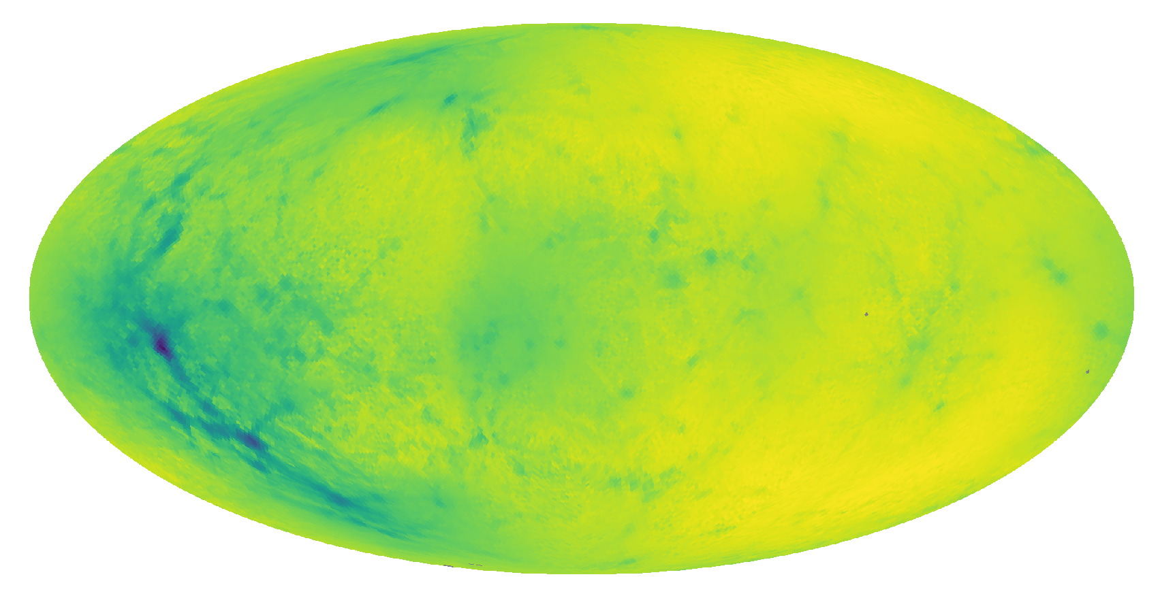
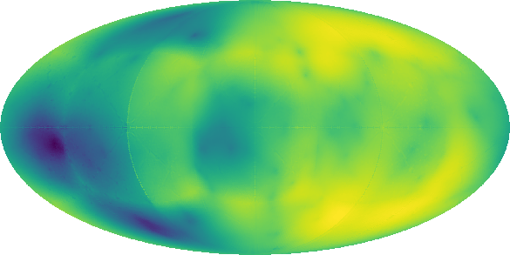
Modifications to L-PICOLA – What is new?
Output of the gravitational potential at the particle positions.
Output of the gravitational potential at the mesh points.
Notes:
What is the picture on left describing?
What is the one on the right ?
How were the images created?
What is their resolution?
How do we get the potential?

Slide 6
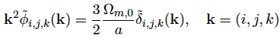
Modifications to L-PICOLA – What is new?
Solving the Poisson equation in Fourier space.
Apply an inverse FFT.
Either Cloud-in-Cell (CIC) interpolation to particle positions and then output or output the potential on the FFT mesh.
Output format either in ASCII or unformatted binary.
Modified version at https://
Notes:
What is the PM algorithm doing?
Where is the potential extracted?
How do we output the the data?
Thank to Uwe Schmitt for ...
Were can the modified version be found?

Slide 7
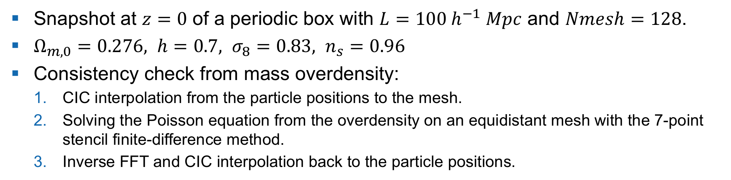

Test simulation and results
Snapshot at $z=0$ of a periodic box with $L=100 h^{−1} Mpc$ and $Nmesh=128$.
$Ω_{m,0}=0.276, h=0.7, σ_{8}=0.83, n_{s}=0.96$
Consistency check from mass overdensity:
CIC interpolation from the particle positions to the mesh.
Solving the Poisson equation from the overdensity on an equidistant mesh with the 7-point stencil finite-difference method.
Inverse FFT and CIC interpolation back to the particle positions.
Snapshot at $z=0$ of a periodic box with $L=100 h^{−1} Mpc$ and $Nmesh=128$.
GADGET-2 simulation to verify the Poisson solver.
Notes:
What have we done to test our modifications out?
What have we done to prove that our results?
Why did we used GADGET-2?

Slide 8
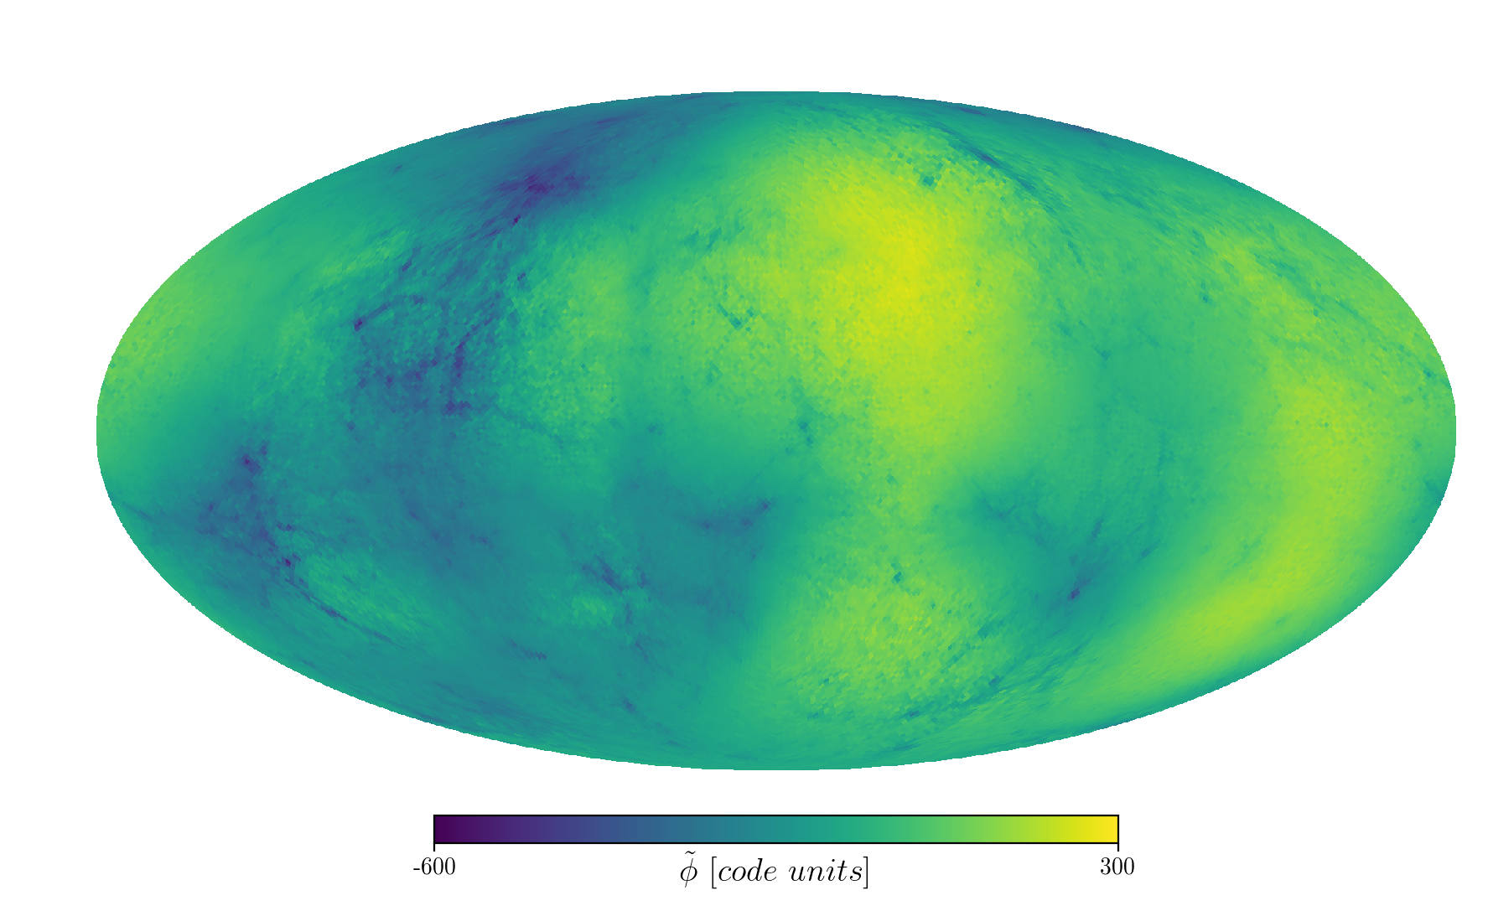

Test simulation and results
GADGET-2 simulation
GADGET-2 poisson
Notes:
What is in the image on the left?
What is in the image on the right?

Slide 9
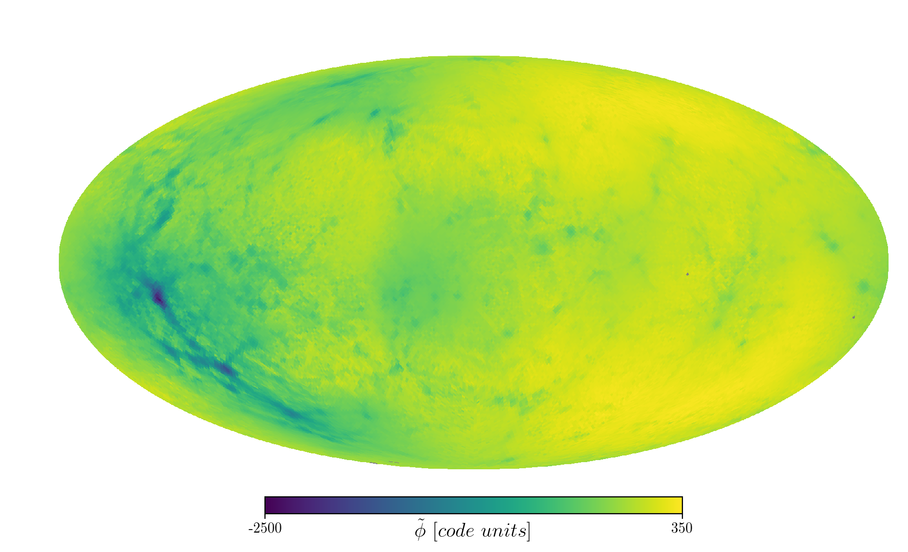

Test simulation and results
L-PICOLA simulation
L-PICOLA poisson
Notes:
What is in the image on the left?
What is in the image on the right?

Slide 10
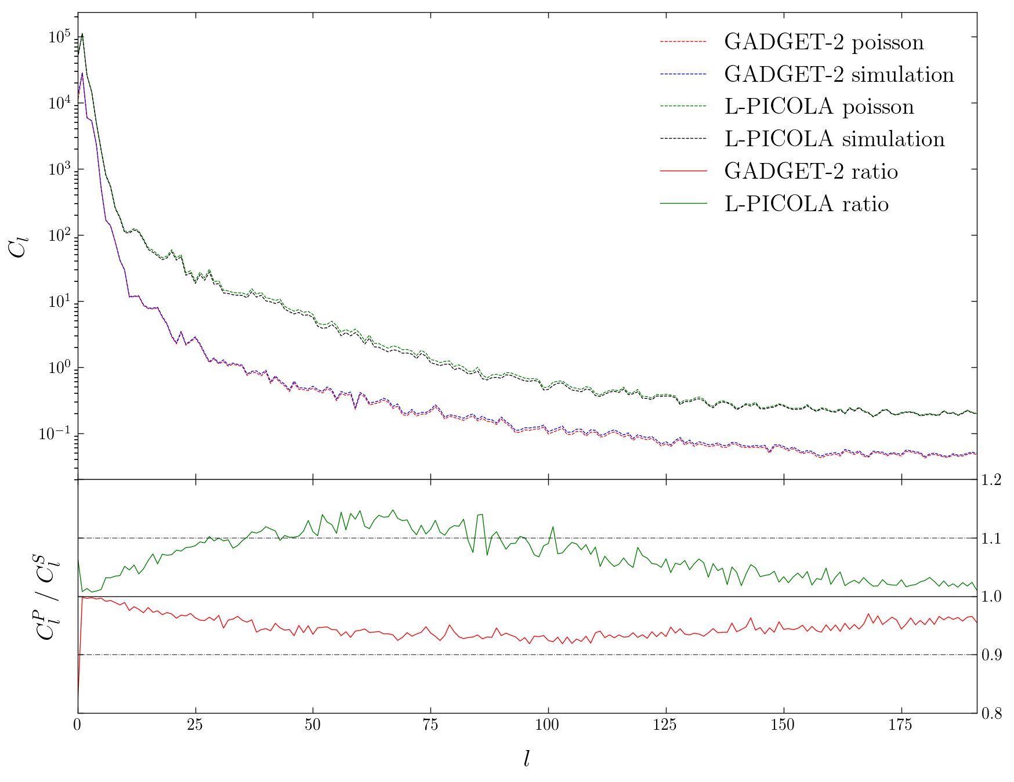
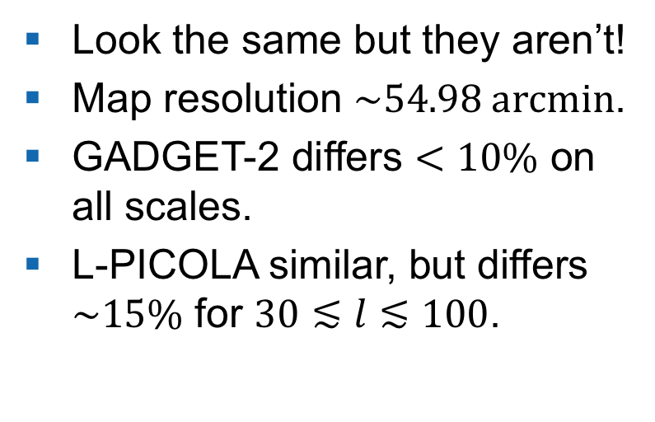
Test simulation and results
Look the same but they aren’t!
Map resolution $\sim 54.98 \text{arcmin}$.
GADGET-2 differs $<10\%$ on all scales.
L-PICOLA similar, but differs $\sim 15\%$ for $30≲l≲100$.
Notes:
What is the upper, lower plot describing?
How did we get the power spectrum?
What are the differernces in GADGET-2 and L-PICOLA?

Slide 11
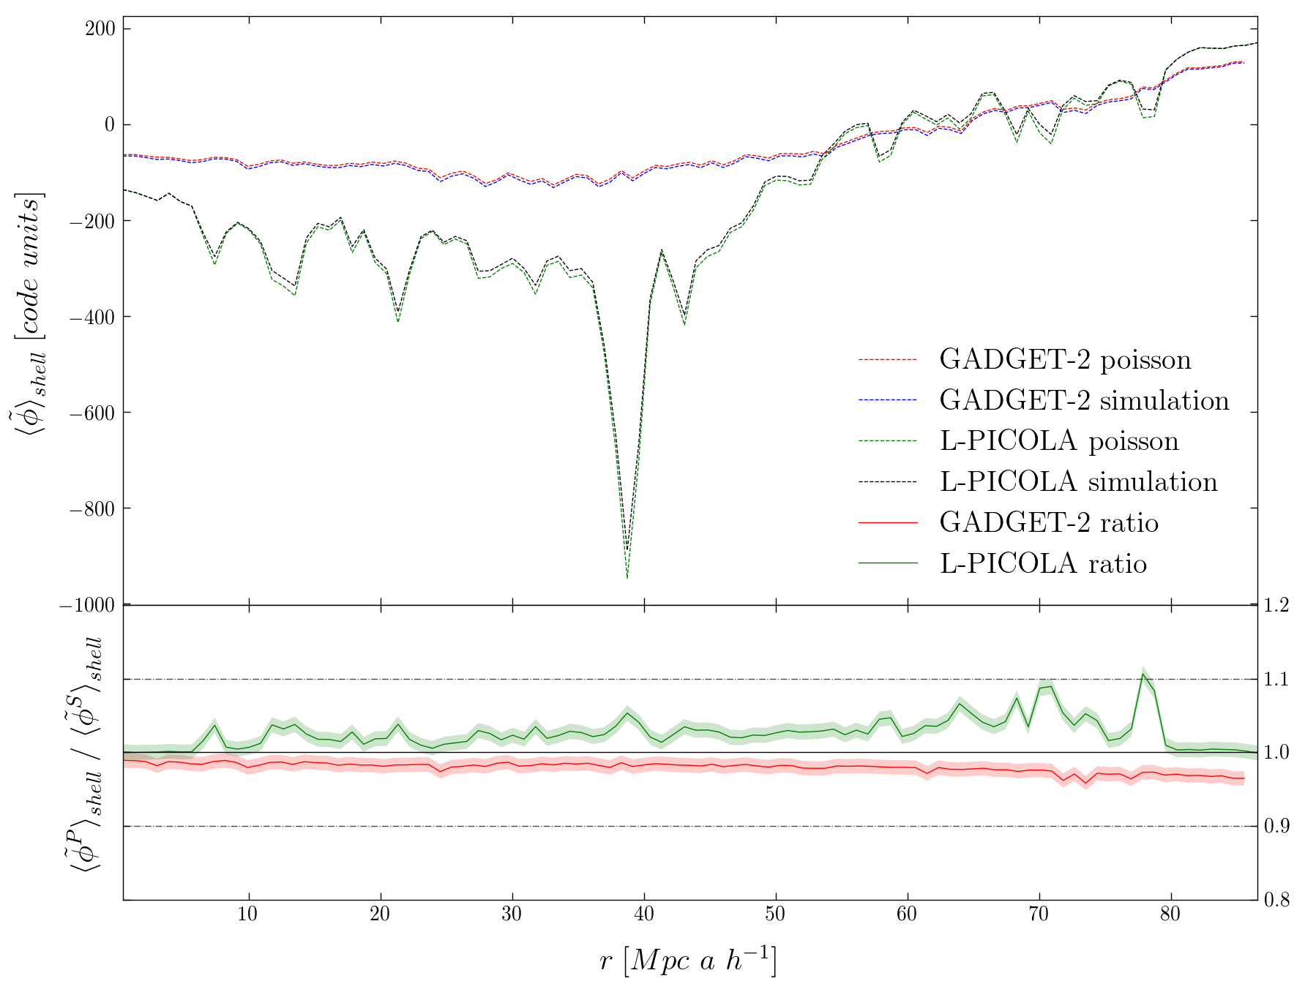
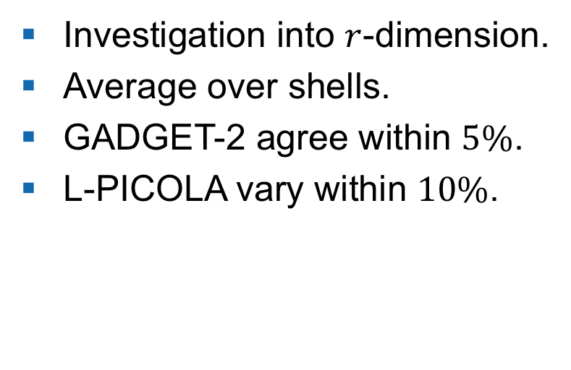
Test simulation and results
Investigation into $r$-dimension.
Average over shells.
GADGET-2 agree within $5\%$.
L-PICOLA vary within $10\%$.
Notes:
What have we done to further analyze the potential?
What is the upper and lower plot describing?
What are the results for GADGET-2 and L-PICOLA?
What does the last two plots tell us about the Poisson solver?

Slide 12
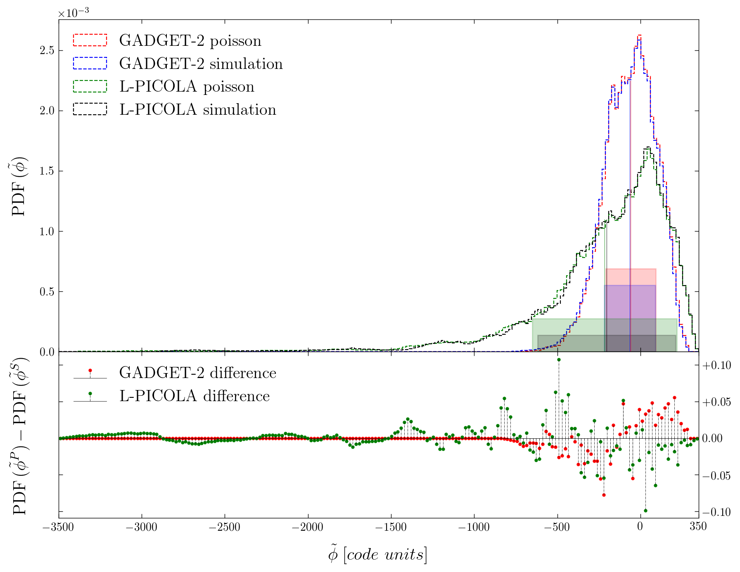
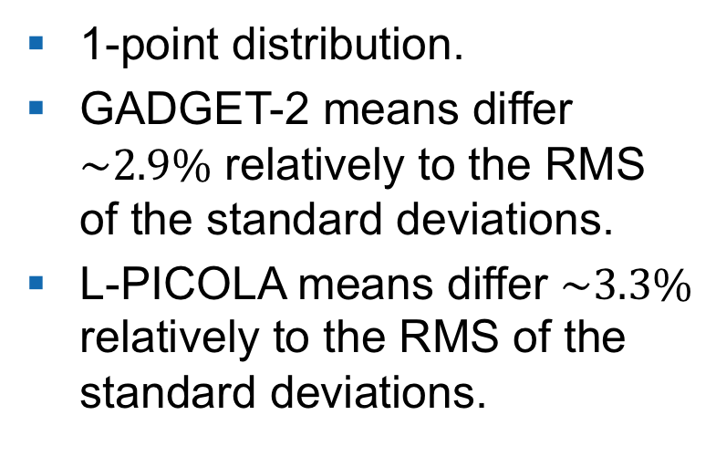
Test simulation and results
1-point distribution.
GADGET-2 means differ $\sim 2.9\%$ relatively to the RMS of the standard deviations.
L-PICOLA means differ $\sim 3.3\%$ relatively to the RMS of the standard deviations.
Notes:
What is the plot describing?

Slide 13
Conclusion
We are able to:
output the gravitational potential at the particle positions.
produce a gravitational potential field.
What comes next?
Transfer the pipeline into lightcone mode.

Slide 14
Contact information and credits
ETH Zurich
Department of Physics
Institute for Particle Physics and Astrophysics
Wolfgang-Pauli-Strasse 27
8093 Zurich
www.ethz.ch/content/specialinterest/phys/particle-physics/ipa/en.html
Publisher: Institute for Particle Physics and Astrophysics
Design: Philipp R. Miotti
Images: ESA and the Planck Collaboration (slide 3)
© ETH Zurich, February 2018

